Slide 1

Leaders in Environment Analysis and Definition of Strategy

Slide 2
[Emre, Insert the video here]

Slide 3
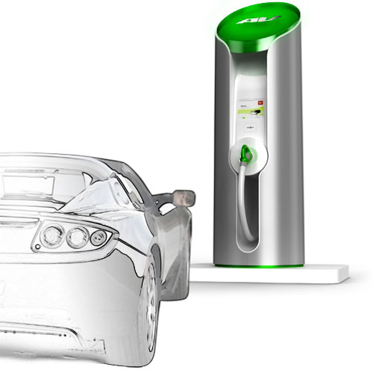
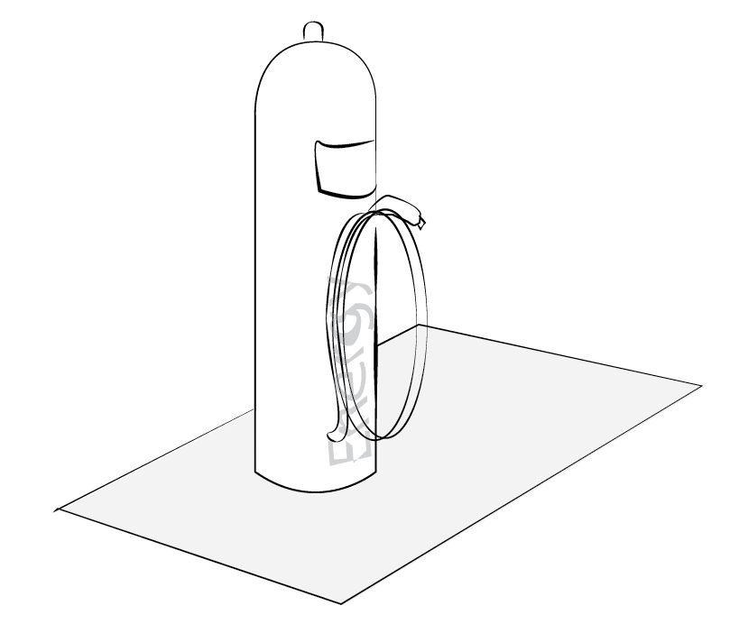
Source: http://www..clubcandoca.com.br

Slide 4
Electrical Car Charging
Connecting
The Grid
Accessibility
Environment
Energy distribution
Data Technology

Slide 5
[Our Project Model]

Slide 6
Input
Output
Participants
The team
The support from the professor, the TA, and their contacts (technical assistance
A one semester-long course
Infrastructure of Tsinghua University
Professor
Companies in the field of electric chargers, oil suppliers, electricity, individuals
Our team
Provide an open-sourced Industrial Analysis Report:
Market research
Research
Investment
Manufacturing
Suppliers
Stakeholders
Infrastructure
Law
Public policy
Current challenges
Social acceptance
Deliver a recorded presentation of the project

Slide 7
Short-term
Medium-
term
Long-term
Get to know each other better as a team
Improved knowledge about the management of a project and useful tools
A good grade for the course
Get inspired by this market for our future career
Companies develop better strategies and decisions concerning this market
Help new innovative companies enter this market
Implementation of the acquired skills in internship, job and other projects
Increased feasibility, reliability of electric cars
Increased development of the electric car market and charging stations market
Better environment due to the decrease of emissions

Slide 8
[Considering the following]

Slide 9
External Factors
Assumptions
We can work correctly together
We can be interested in the subject for the semester
The resources are adequate and available
The companies know about the existence of this industrial analysis report
This industrial analysis report is relevant and useful for companies
The developments of technology in the vehicle market and their relevance, f.e.:
Hybrid technology
Electric technology
H₂ technology
Other technologies

Slide 10
Leaders in Environment Analysis and Definition of Strategy

